Slide 1


Slide 2

Strategic, Pre-Emptive Competitive Gameplay
Simple Systems that are quick to learn, but have a lot of depth
Local, face to face, multiplayer

Slide 3
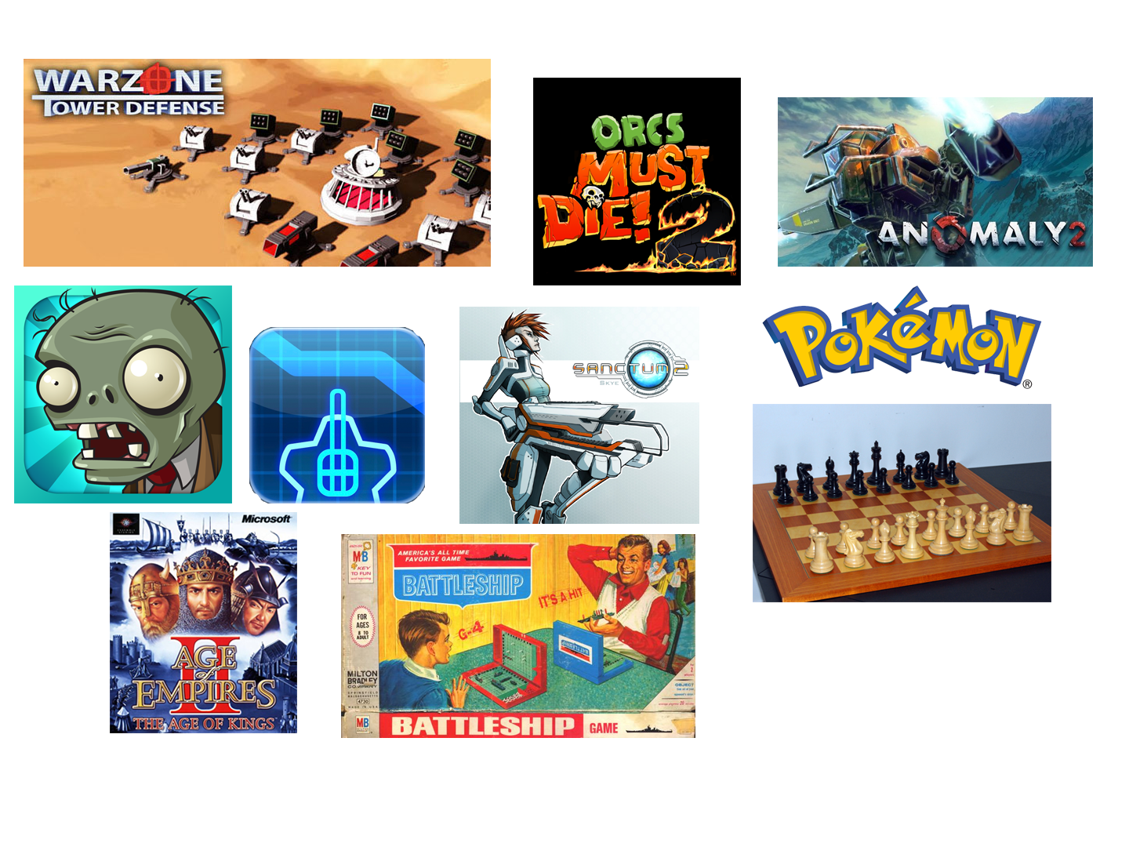


Slide 4

Objective
Get minions past opponents minions & towers
Damage opponents base
Destroy base to win game

Slide 5
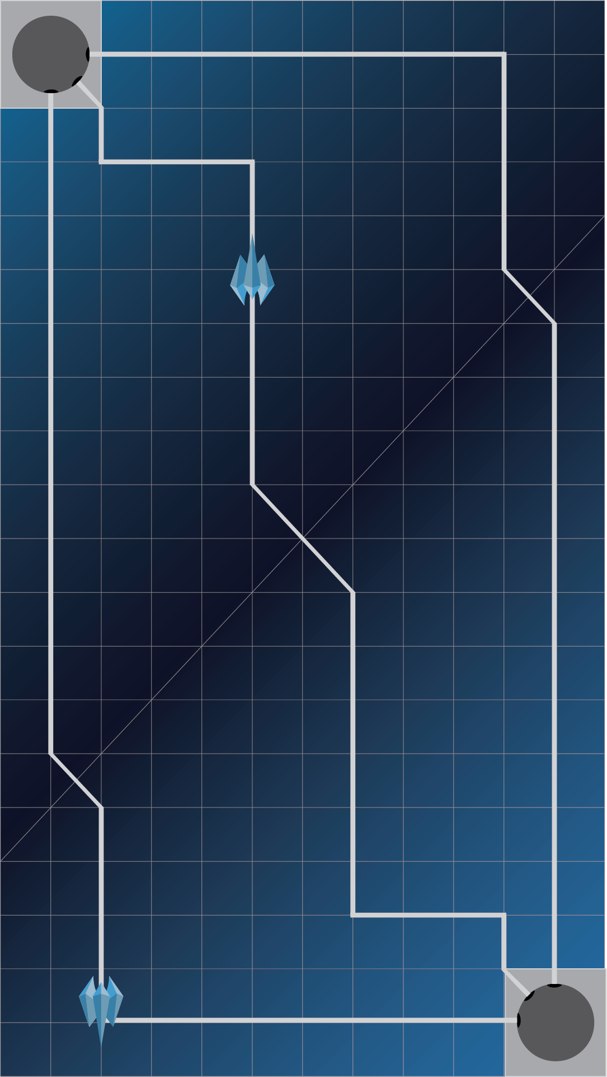
2 Phases
Planning/Building Phase
Asynchronous
Active Battle Phase

Slide 6
The rule of 3
3 types of minions
3 types of elements
3 types of towers

Slide 7
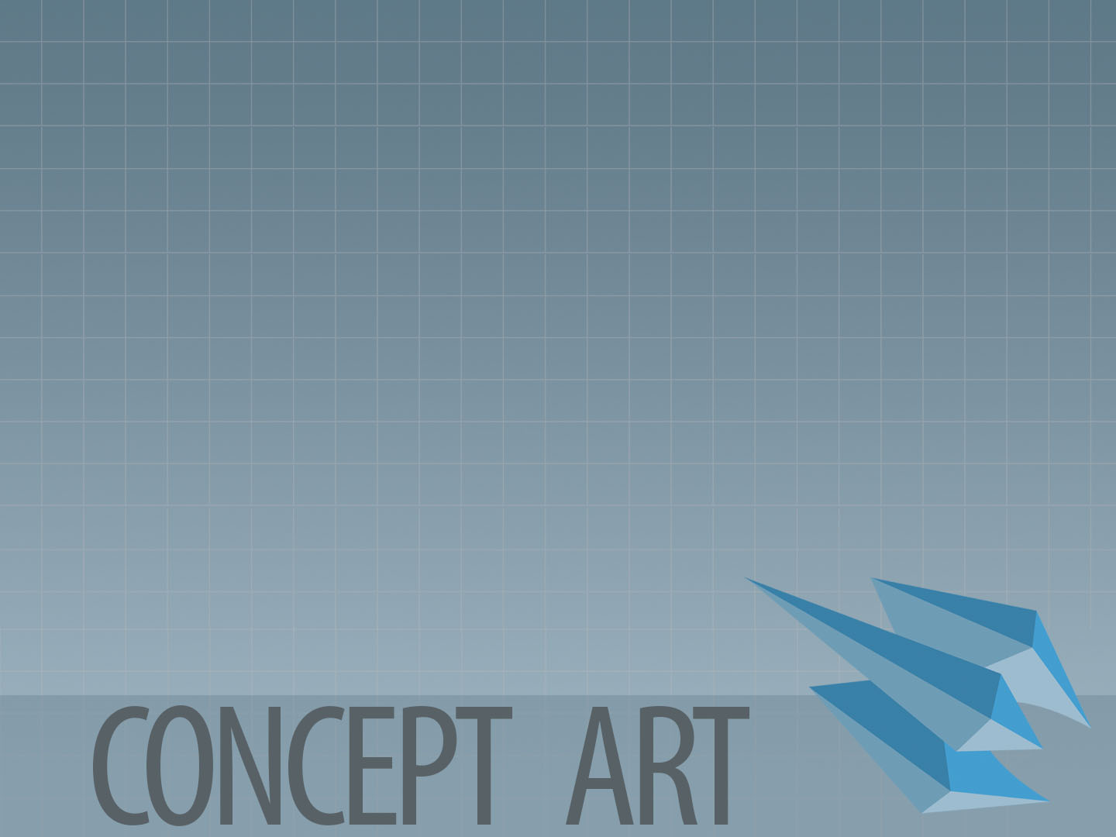
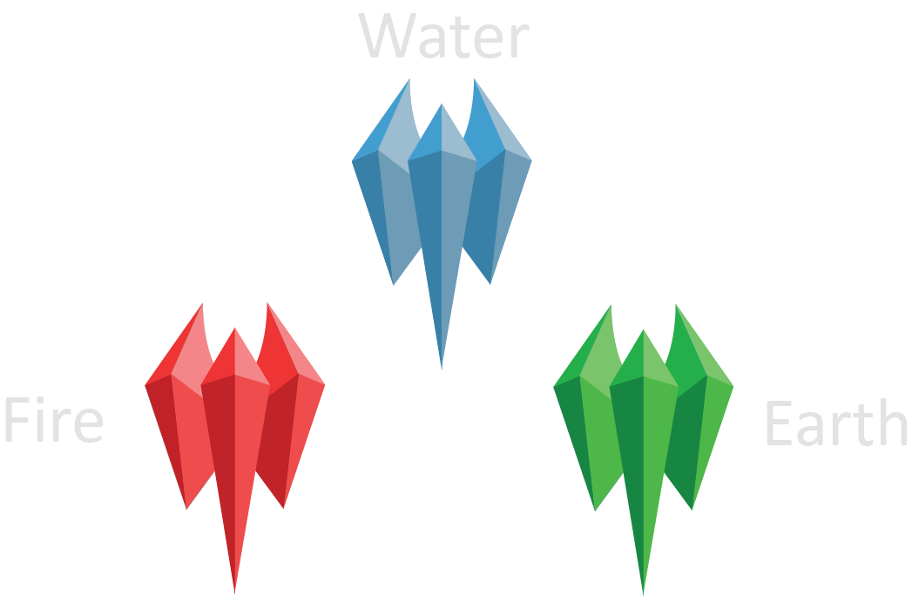

Slide 8
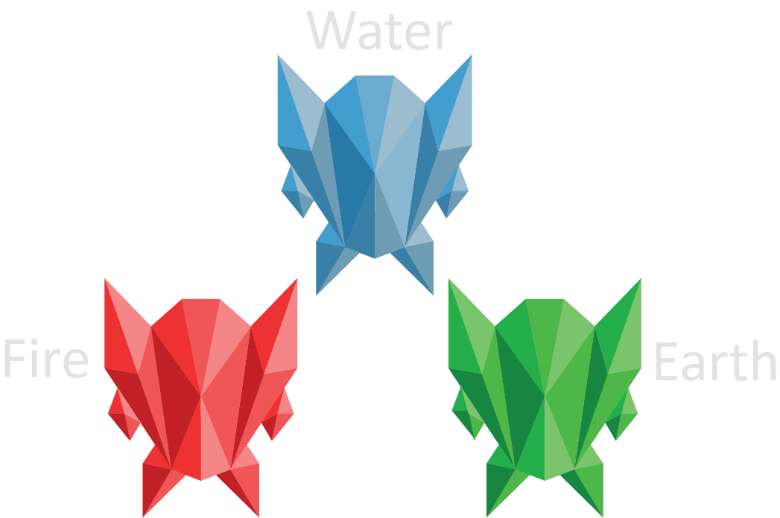

Slide 9
Game Map

Slide 10

Game Map

Slide 11

Assuming…
Windows 8 Surface Pro Tablet
Ability to develop in Unity

Slide 12

Cosmetic & aesthetic customization
Expanded Game Play packs

Slide 13

A proven & popular genre on mobile
Plants vs. Zombies
GeoDefence
Field Runners
Kingdom Rush
Target Demographic:
8+
People looking for spare time gameplay in a social setting

Slide 14

Prototype
Proof of concept built in processing
Alpha:
Feature complete version of game in Unity
Beta:
Balancing, Testing, Polishing on mobile platform
Gold:
COMPLETE!

Slide 15


